Slide 1

PHARMA BRIDGE
Project Title: Pharma Bridge
Domain: Healthcare
Team Name: BlockBusters
Team Members:
Pritesh Mantri
Yash Ladda
Samiksha Deshpande
Dept. Hackathon: CS-SE and IOT Edition

Slide 2
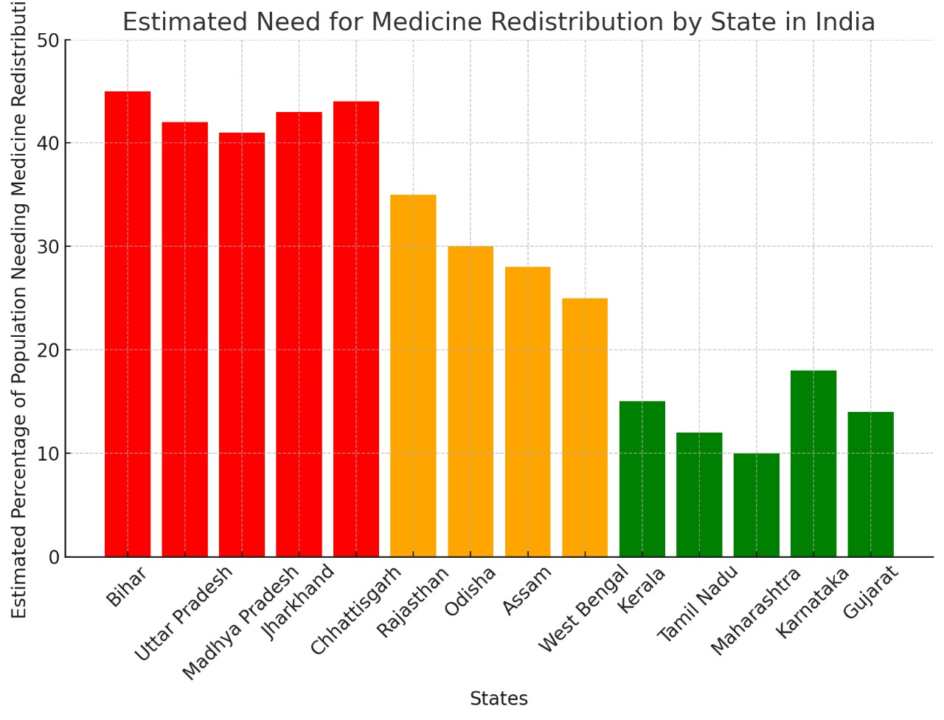

India generates 5-10% pharmaceutical waste annually due to expiry and improper storage, while 65% of the population lacks access to essential medicines. Despite 70% of pharmaceutical companies engaging in CSR, structured medicine donation remains low. A platform is needed to redistribute near-expiry medicines efficiently.
Problem Statement
Healthcare - Problem Statement 2:
Medicine Redistribution System
Description: How can we create a system to collect unused, non-expired medicines and redistribute them to those in need?
Objectives:
Efficient Medicine Collection & Redistribution
Smart Matching & AI-Based Optimization
Transparency & Trust in the System
User-Friendly & Scalable Digital Platform
Improve Healthcare Access & Reduce Medicine
Wastage
Dept. Hackathon: CS-SE and IOT Edition

Slide 3
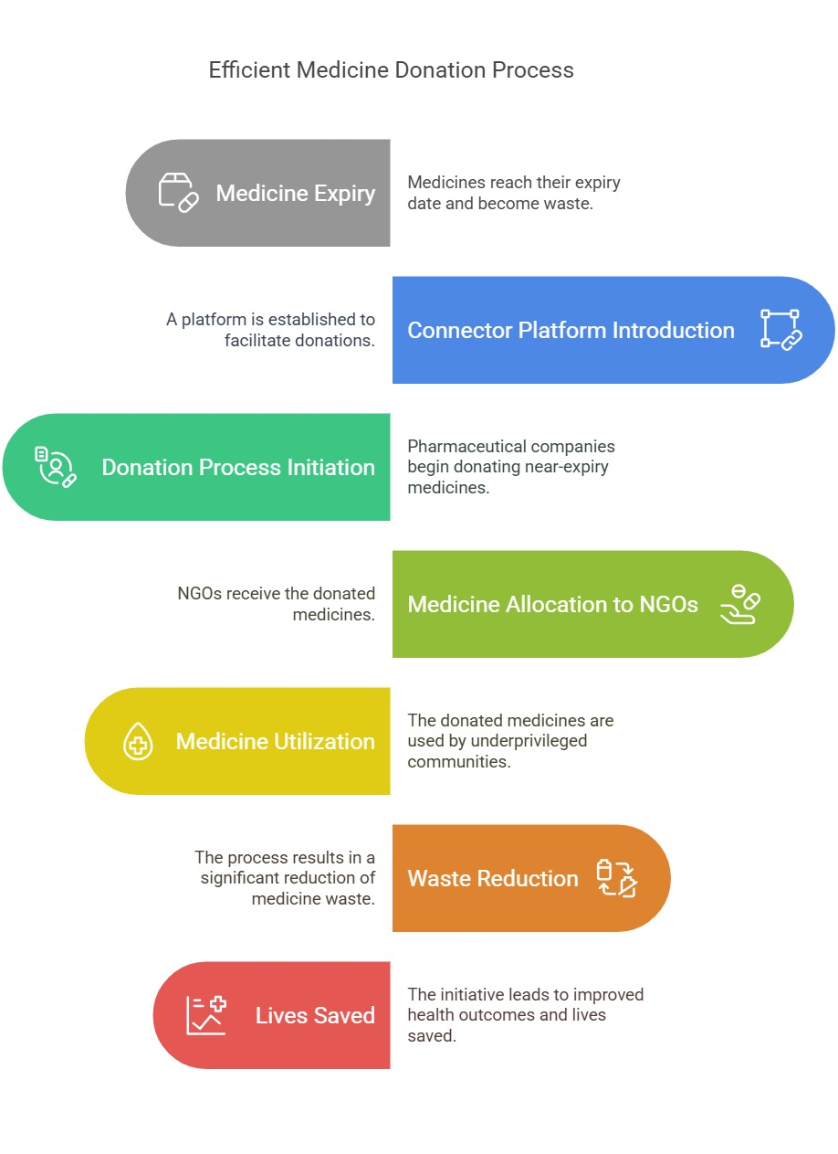
Ideation
Every year, millions of medicines from pharmaceutical companies and healthcare centers go to waste due to expiry, while thousands of NGOs struggle to access essential medicines for underprivileged communities.
A dedicated connector platform is required to bridge the gap between large pharmaceutical companies and NGOs, ensuring that near-expiry medicines are donated and utilized efficiently in transparent and secured manner resulting in reducing waste, saving lives.
Dept. Hackathon: CS-SE and IOT Edition

Slide 4
Innovation
We are developing a groundbreaking platform that unites pharmaceutical companies and NGOs with a view to facilitating near-expiry drug donation.
Millions of drugs go to waste annually while there are thousands of NGOs that cannot access vital supplies. Our platform bridges this gap by allowing companies to post excess drugs and NGOs to request or claim them.
Through AI-enabled matching, expiry tracking on automatic, and secured logistics, we ensure efficient and timely delivery. Blockchain authentication assures greater transparency and accountability to rule out any malpractices.
By making use of technology and CSR partnerships, we seek to reduce wastage of pharmaceuticals and raise access to medicine for the vulnerable.
Dept. Hackathon: CS-SE and IOT Edition

Slide 5
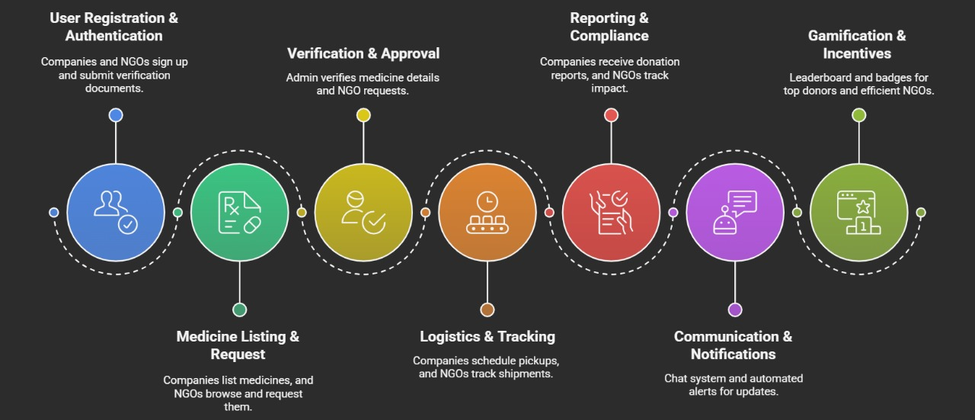
WORKFLOW
Dept. Hackathon: CS-SE and IOT Edition

Slide 6




Approch(Technical)
TECHNOLOGY STACK
1️⃣HTML, CSS, JS (Frontend) → Users register donations, request medicines and track distributions.
2️⃣ Node.js + Express (Backend) → Processes requests, stores data, and handles business logic.
3️⃣ MySQL (Database) → Stores donor, medicine, and recipient records securely.
4️⃣ AI (Intelligence Layer) → Automates medicine matching, expiry detection, and verification.
Dept. Hackathon: CS-SE and IOT Edition

Slide 7
Conclusion
✔ Efficient Medicine Collection & Distribution – Collects unused, non-expired medicines and redistributes them to NGOs and healthcare centers.
✔ Technology-Driven Solution – Uses React.js, Node.js + Express, MySQL, and AI for seamless donation, verification, and tracking.
✔ AI-Powered Smart Matching – AI optimizes medicine allocation, prioritizing urgent needs and minimizing wastage.
✔ Transparency & Accessibility – Ensures a trusted, real-time monitoring system for donors, NGOs, and admins.
✔ User-Friendly Platform – Provides a simple and intuitive interface for donors, NGOs, and healthcare organizations to easily participate.
✔ Medicine Expiry Management – AI-based expiry prediction ensures timely distribution and prevents wastage of medicines.
✔ Scalability & Future Expansion – Can be expanded to new cities, states, or even globally, integrating more NGOs and healthcare partners.
Dept. Hackathon: CS-SE and IOT Edition

